Slide 1
INFO 6150 FINAL PROJECT TRAVEL GLOBE
Developed by:
Andrea Sequeira - 2619793
Bhagyashri chavan - 2939515
Nishi Pancholi - 2620349
Sharvika barapatre - 2192964
Rushikesh Dalvi - 2922393

Slide 2
PURPOSE:
Travel Globe offers a range of features to help users plan their travel itineraries, including access to weather information and recommendations for hotels, bars, parks, and shopping malls in their desired travel destinations.
Users can use voice recognition to search for information on their destination, as well as share their experiences through blog posts that can be shared on social media platforms
Administrators have the ability to manage blog content by reviewing and deleting posts as necessary
Additionally, users can explore and bookmark places they're interested in visiting for future trips.

Slide 3
TECHSTACK:
React JS
Node JS
Express
Mongo DB
Multer
MUI
Bootstrap
EmailJS
Webkit voice recognition
Google Maps & Places API
Weather Stack API

Slide 4
CONTRIBUTIONS:
Andrea Sequeria
- Weather Feature, Register, Log in, and Log out of users & Admin
Bhagyashri Chavan
- Forgot Password Feature, Explore Places Backend and API call, Home Page
Nishi Pancholi
- Add Experience Page, View Blogs Page, My Account Page
Sharvika Barapatre
- View Blogs Page, Voice Search, Google Maps API, Search City
Rushikesh Dalvi
- Explore places frontend, CRUD operations on Blogs, Google Places API, Search City

Slide 5

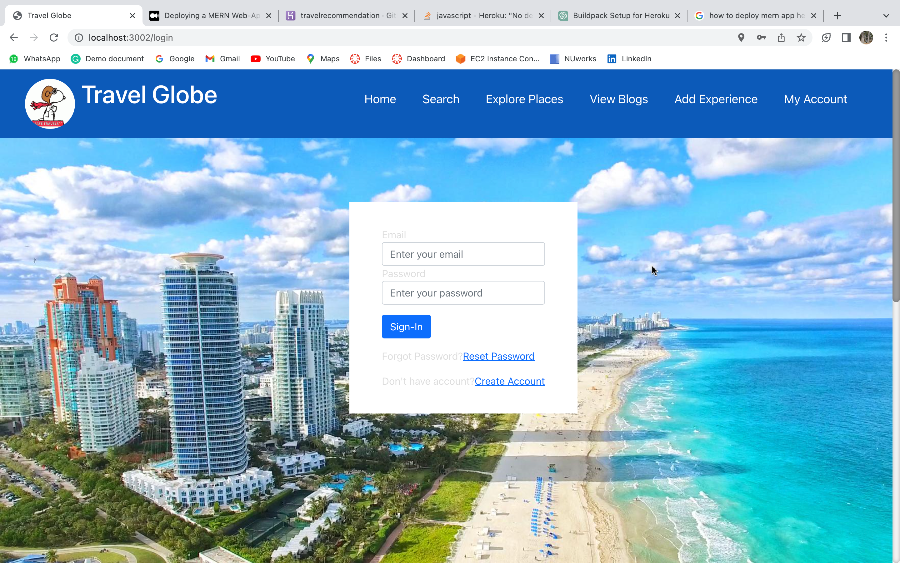





Slide 6
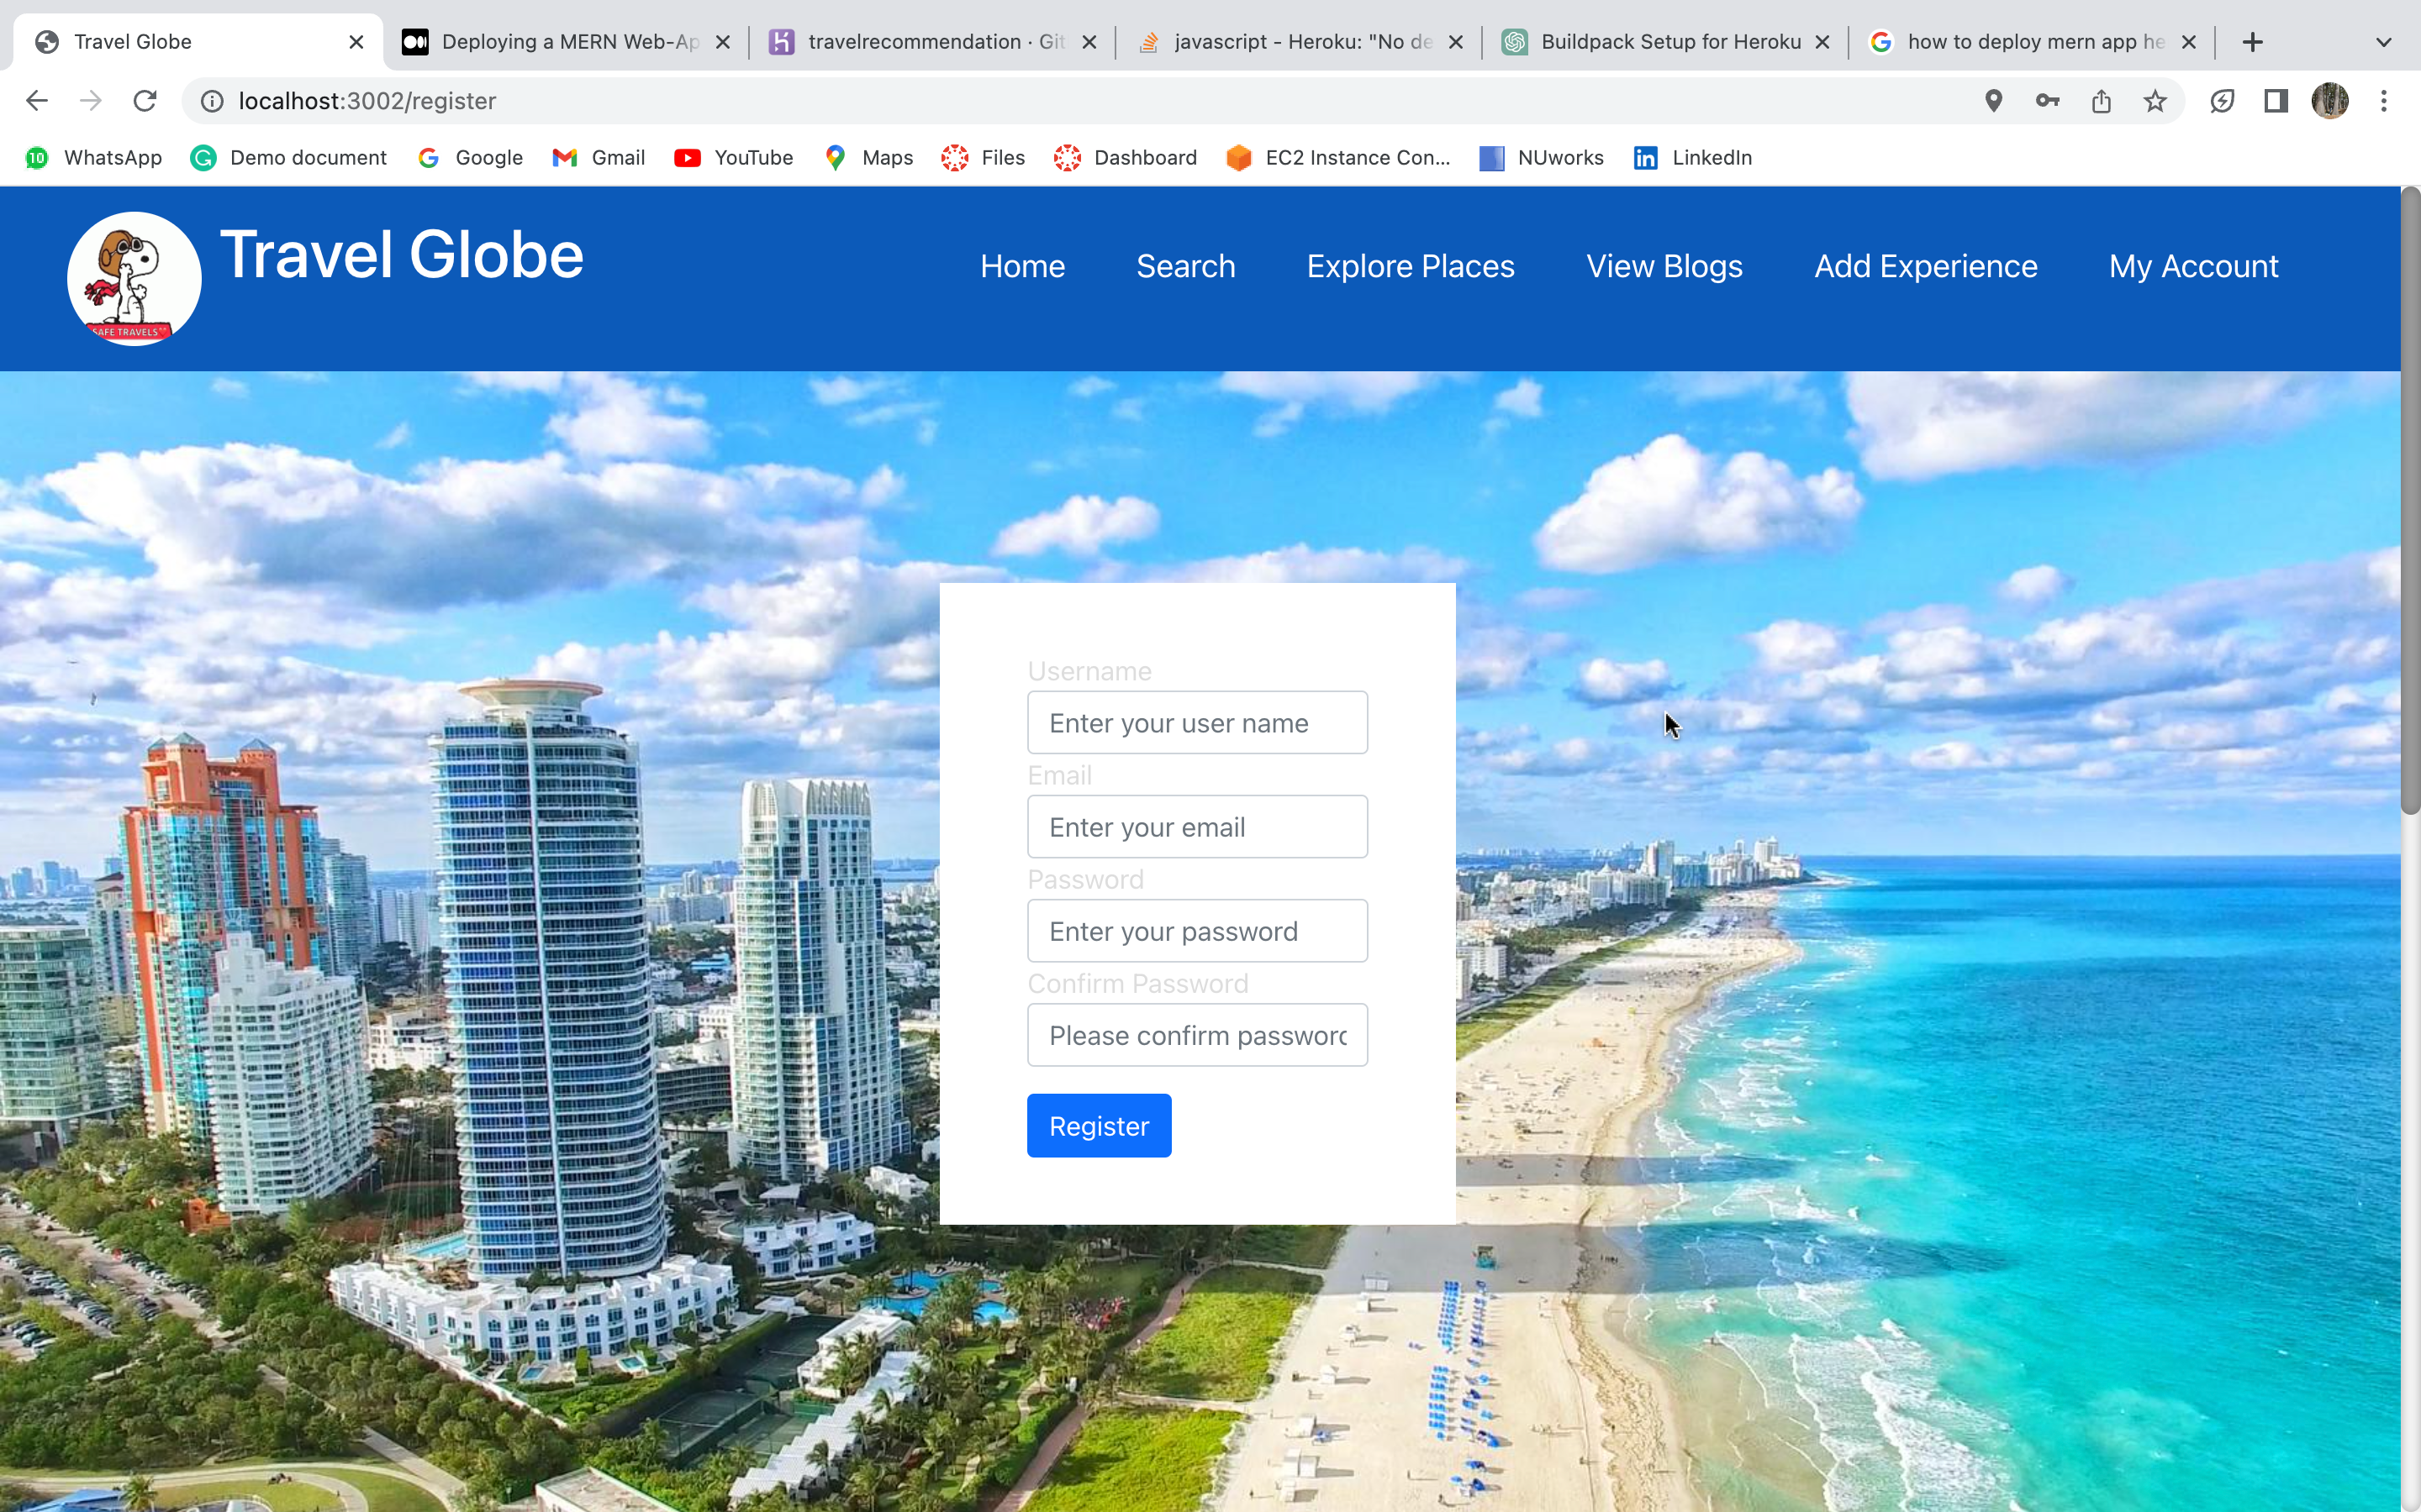

Slide 7
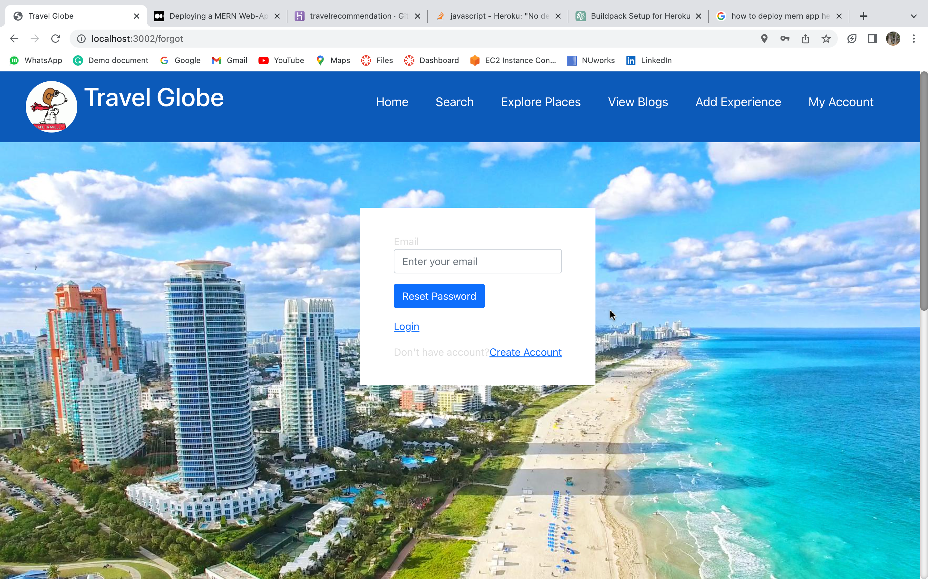

Slide 8
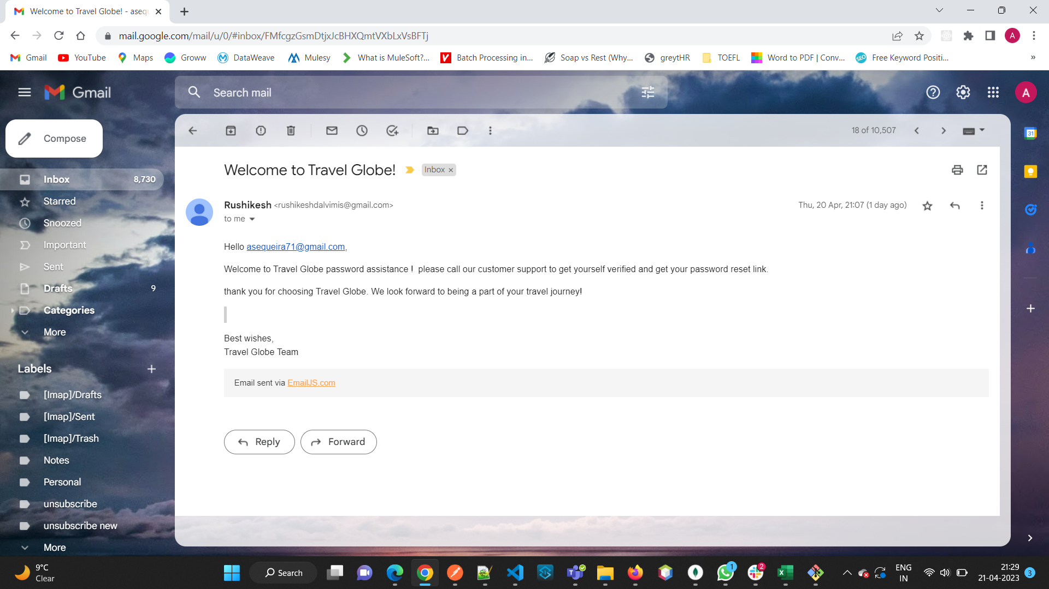

Slide 9
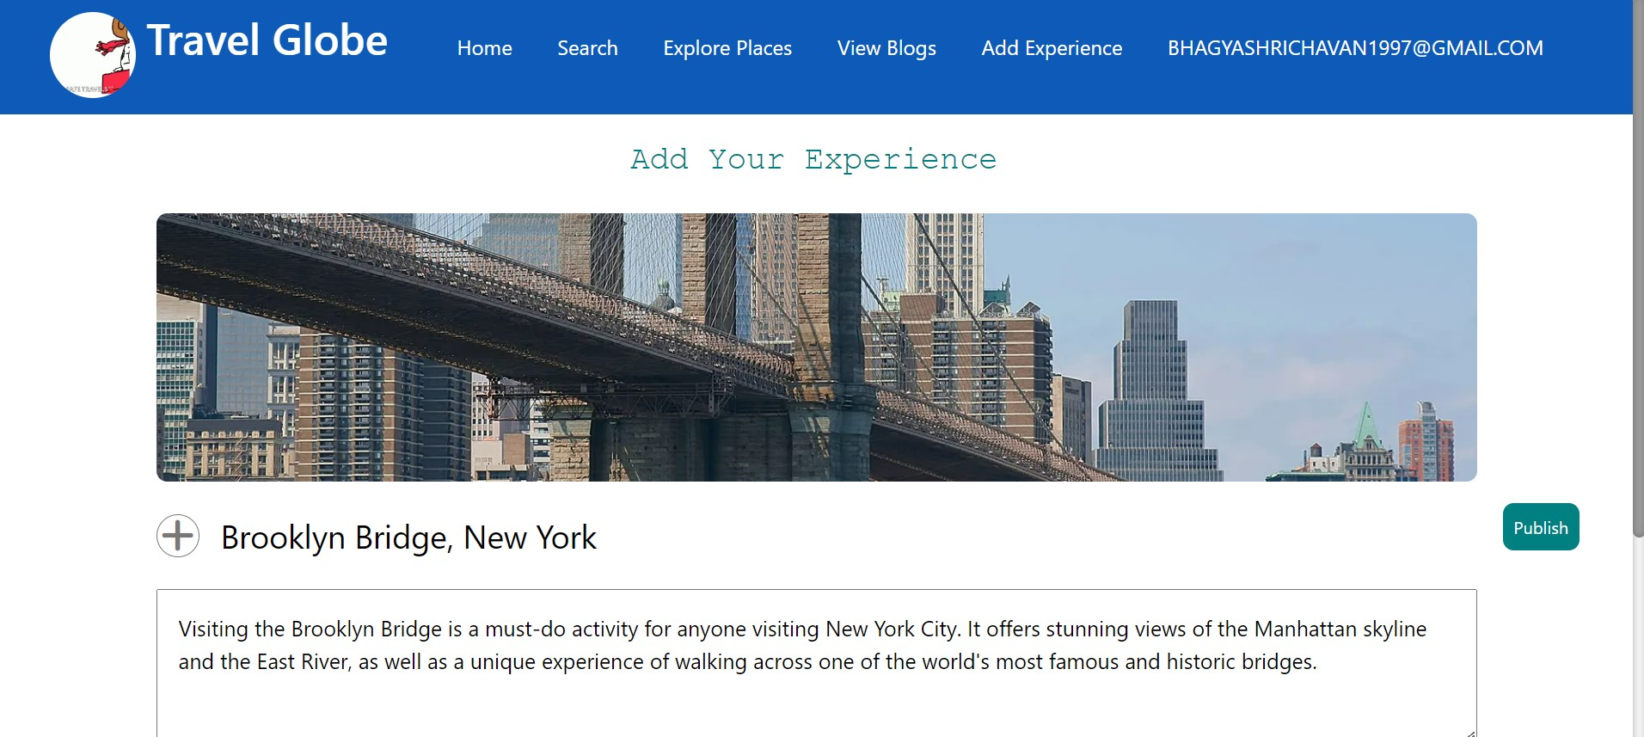

Slide 10
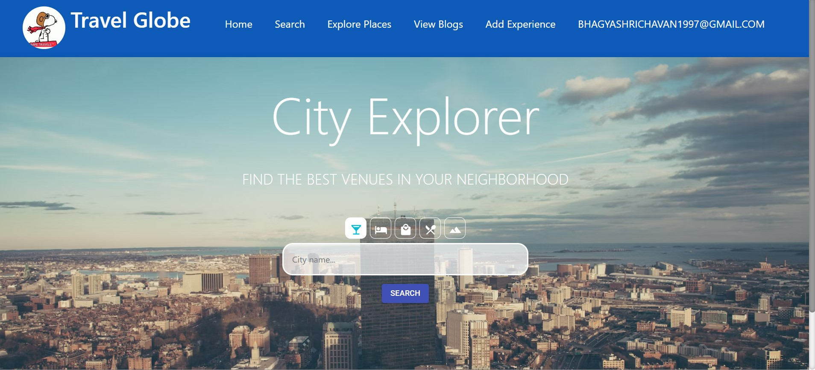

Slide 11
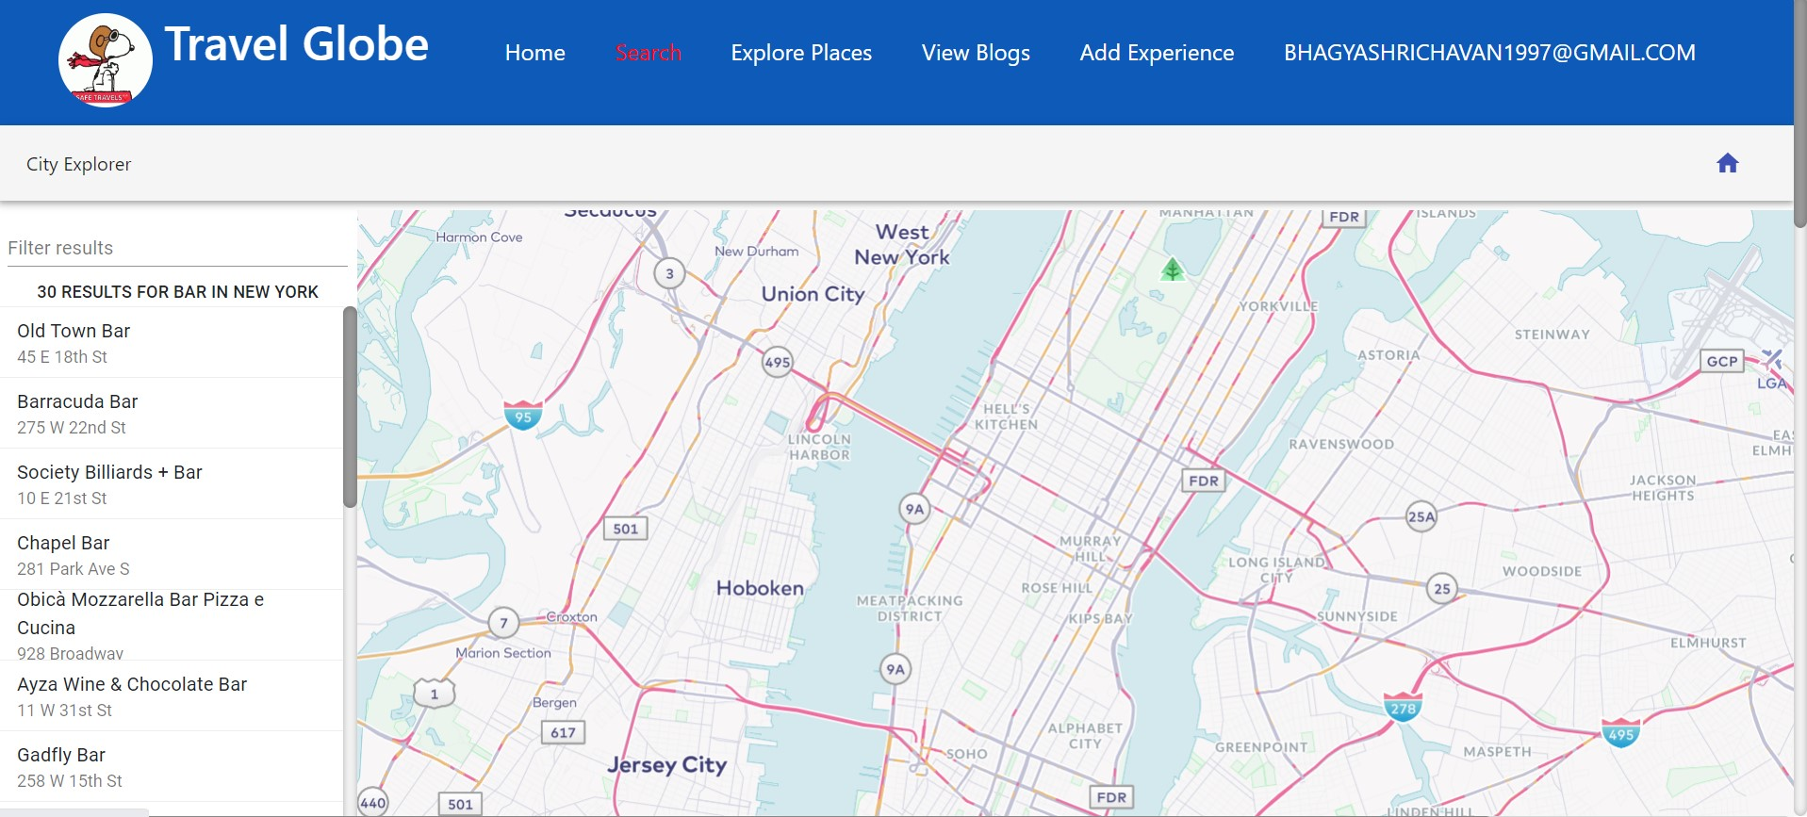

Slide 12
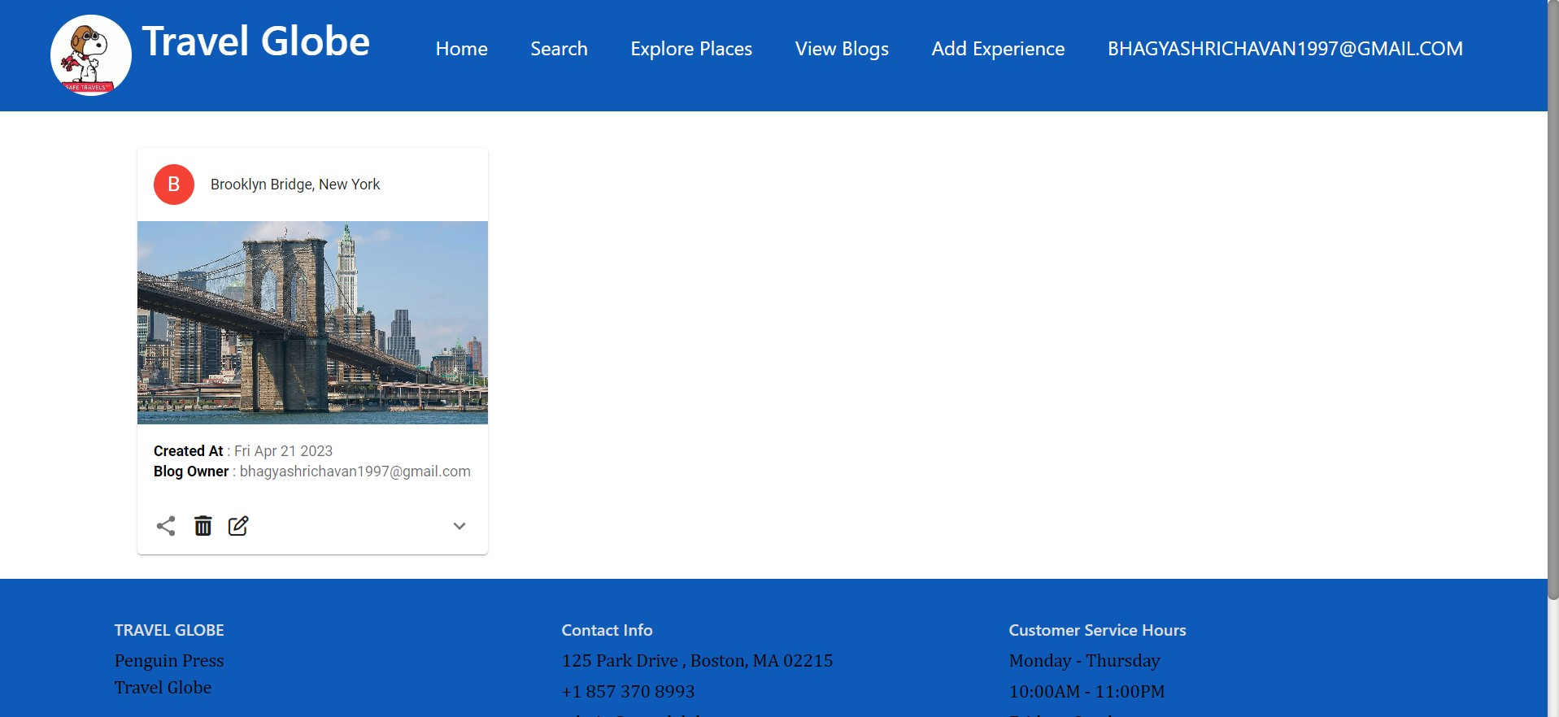

Slide 13
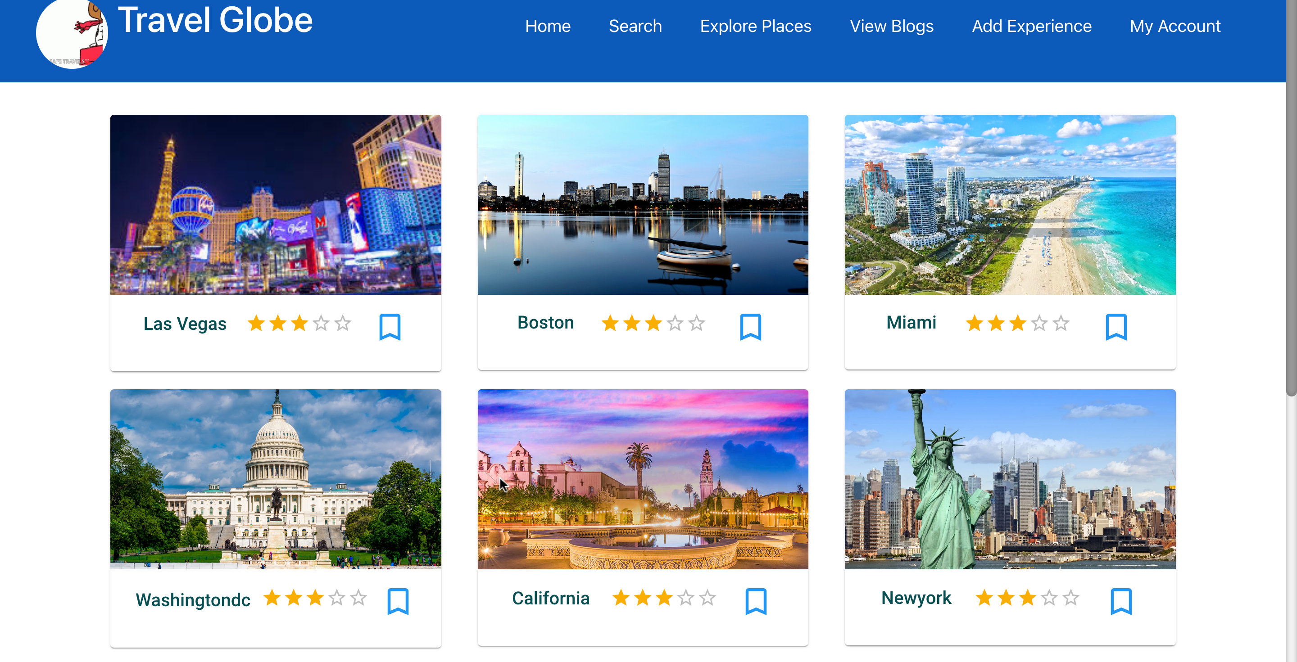

Slide 14
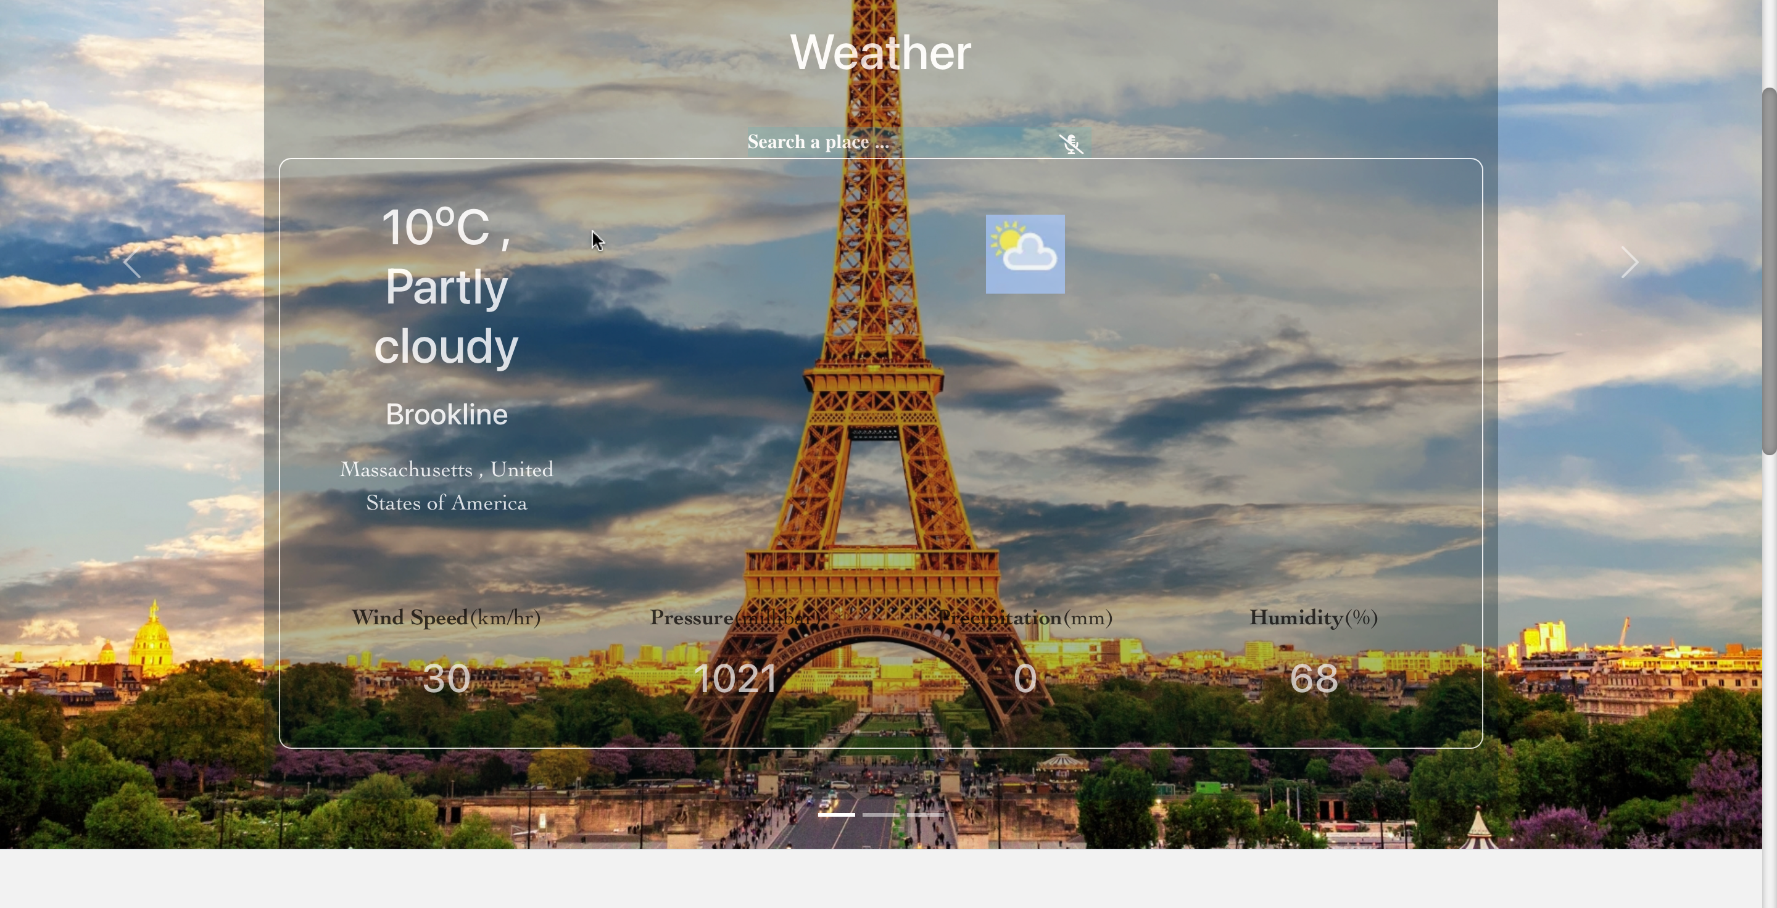

Slide 15
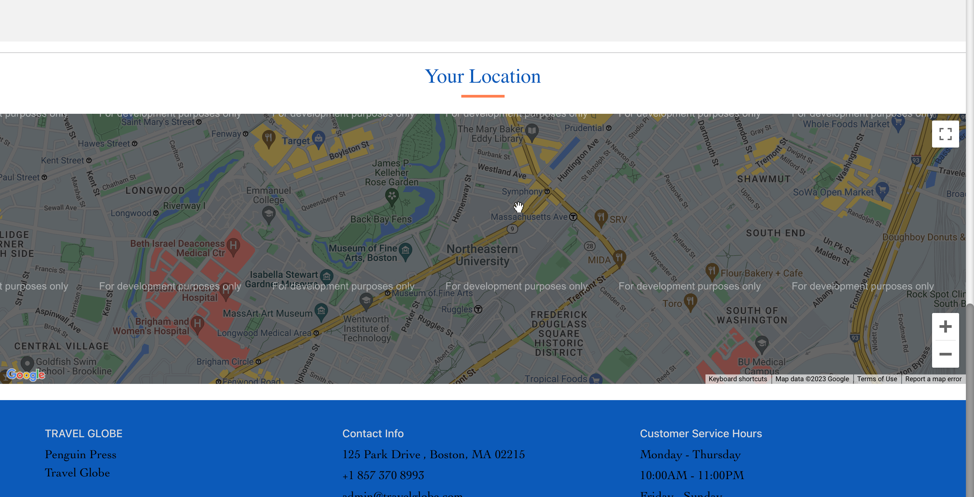

Slide 16
REFERENCES:
https://www.tripadvisor.com/
https://makemytrip.com/
https://www.w3schools.com/

